Slide 1
Connected & Automated
Vehicle Technologies
& Utility Demands
A Panel Discussion with Partner Experts - Matthew Graf and Thomas Timcho from HNTB
RESEARCH
ABSTRACT
DESIGN

Slide 2
An overview of connected & automated vehicle technology deployment in Kentucky and how it will impact the infrastructure we typically consider a utility.

Slide 3
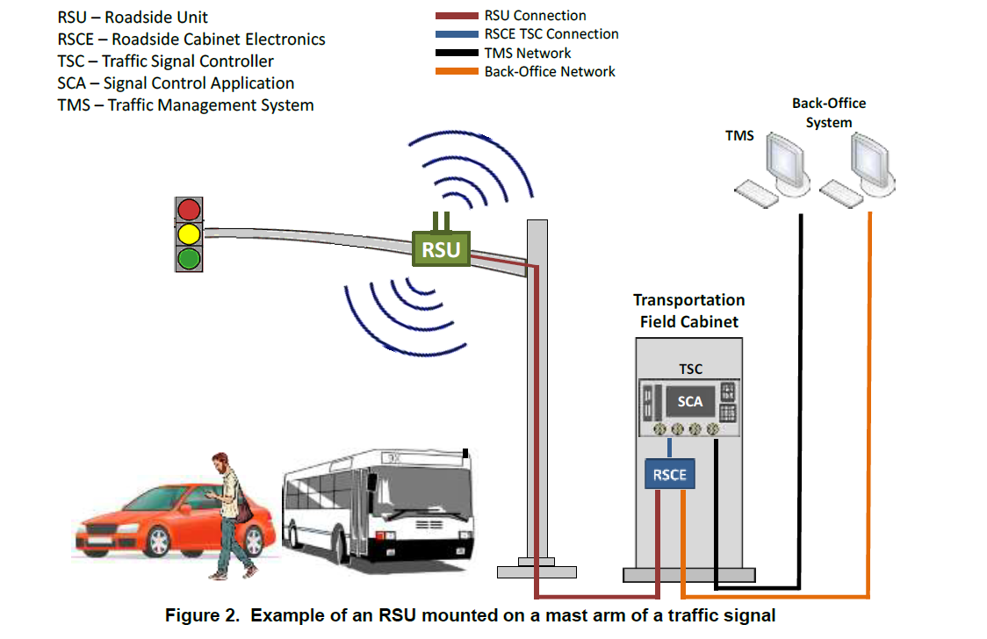
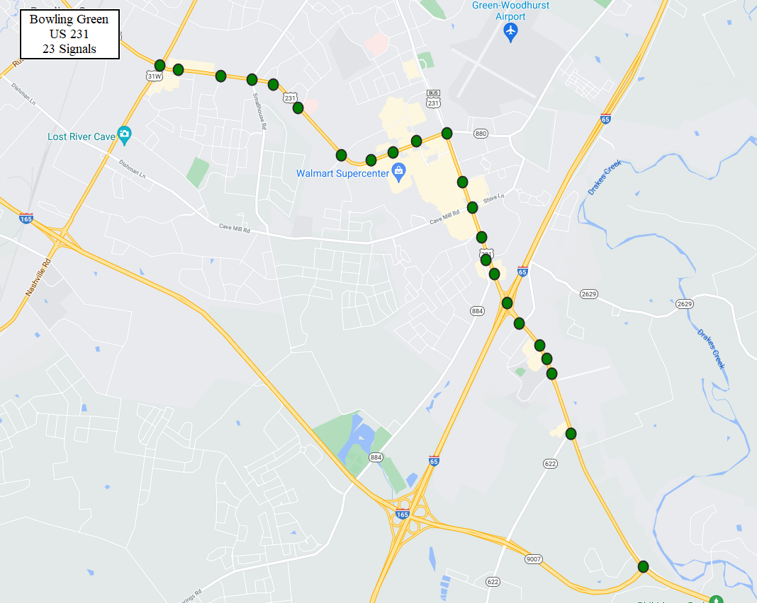
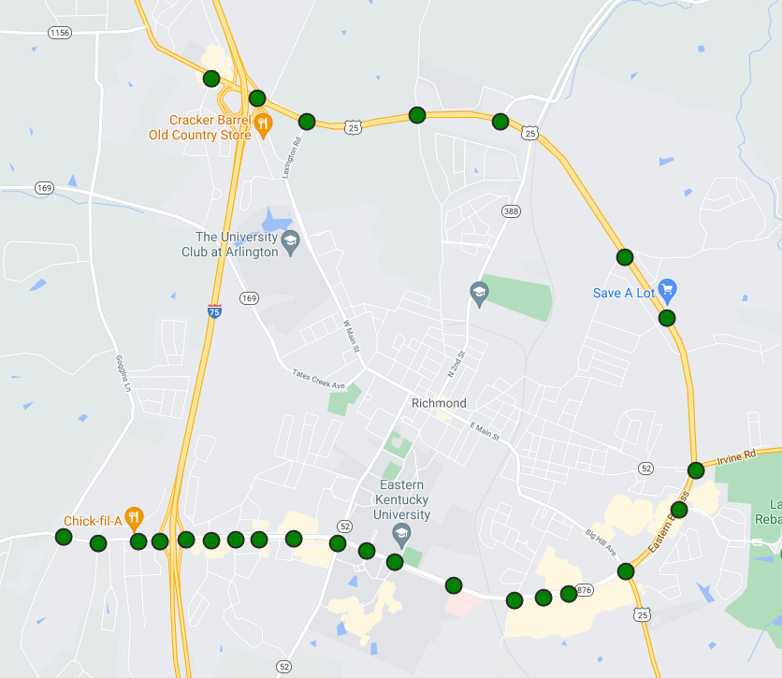
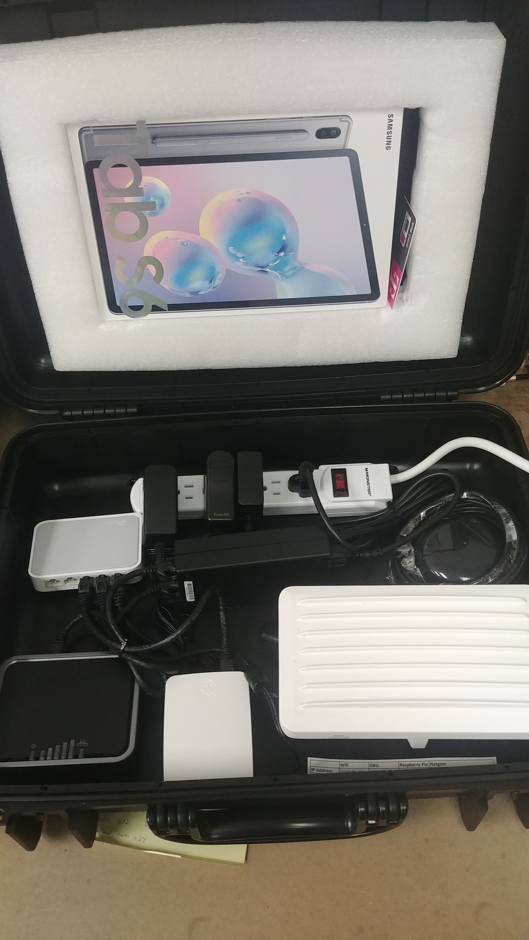
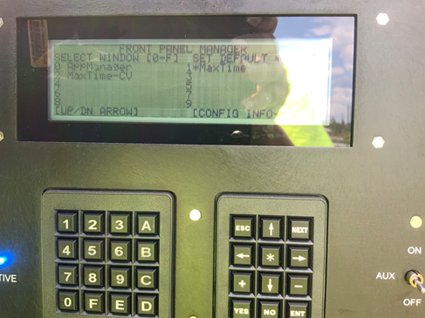
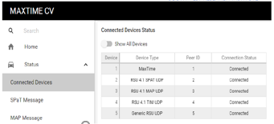
Connected Vehicle Corridor Deployments in Kentucky
RSU
Richmond
KY 876
26 signals
OBU
MaxTime CV Module installed on Controller

Slide 4
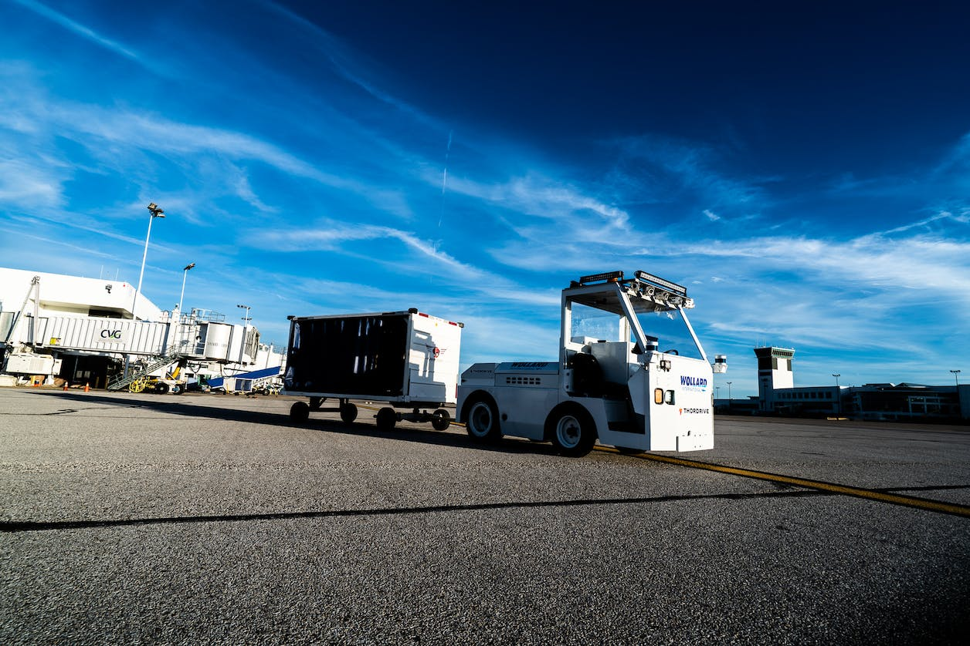
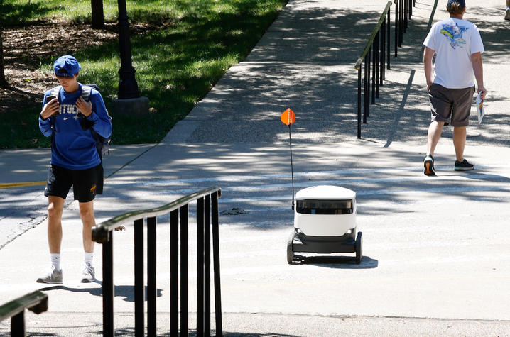
Automated Vehicle Deployments in Kentucky
Louisville
Northern Kentucky
Lexington
GE Appliances’ collaboration with Einride began in 2021. In October of 2021, we announced an electric, autonomous POD pilot at GE Appliances’ 750- acre company headquarters in Louisville, Kentucky. This was the first autonomous and electric pod to operate in the U.S.
ThorDrive has worked with Wollard International to install its technology on a baggage tractor and has partnered with Cincinnati/Northern Kentucky International Airport (CVG) to bring autonomy to airside ground support operations.
LEXINGTON, Ky. (Oct. 20, 2022) — It has been one year since Starship Technology’s food delivery robots made their debut on the University of Kentucky’s campus.

Slide 5
BACKGROUND

Slide 6
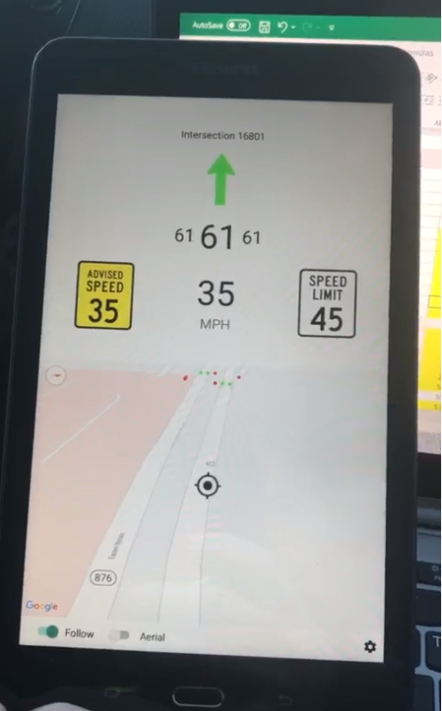
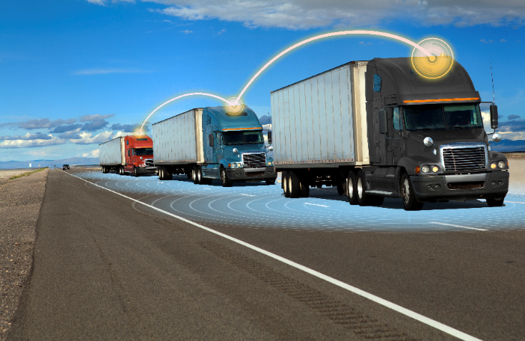
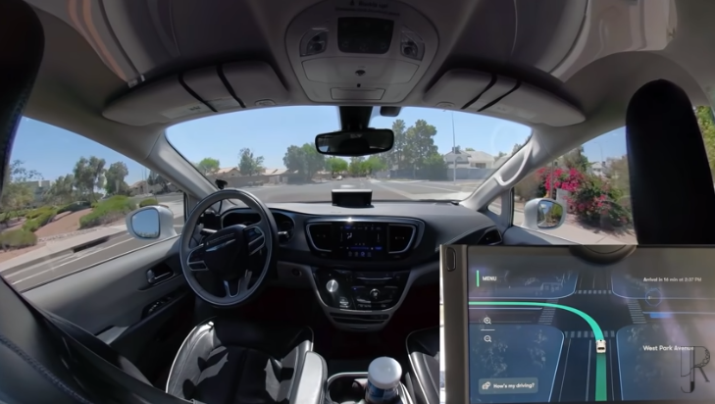
Two technologies developing on separate paths that are projected to merge.
Example Applications
Platooning
In Vehicle Display of
Count Down to Yellow
Automated Driverless Taxi
Connected + Automated = Cooperative

Slide 7
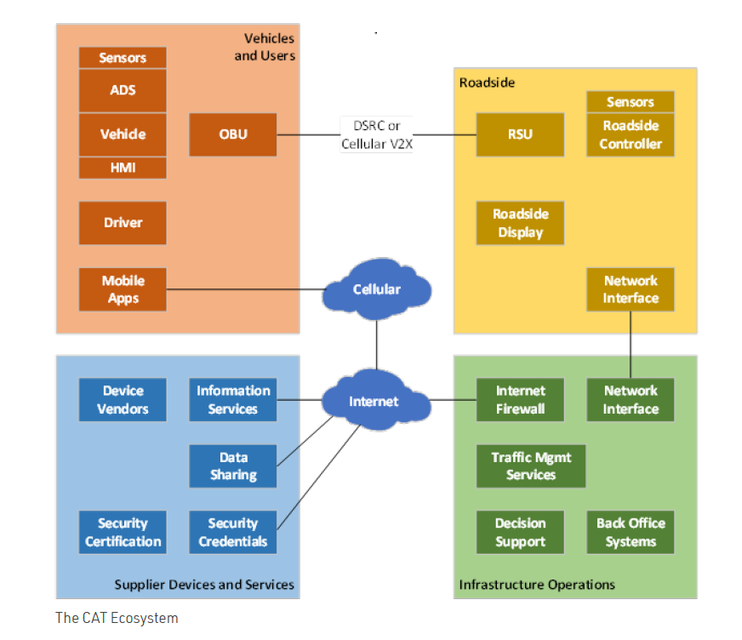
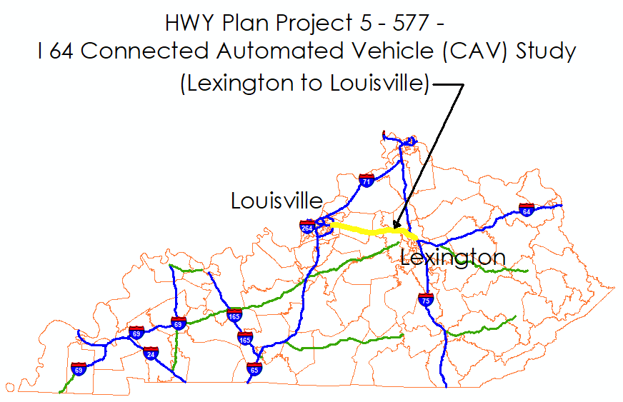
Future Deployments in Kentucky
Connected + Automated = Cooperative

Slide 8
So what does that mean slide…
Notes:
What do we need? Power? Communications? Where do these go? Is a pole part of a Utility? What is the ability of adding these? Where does lighting play into av needs? Does CORS become a utility? Share Fiber?

Slide 9
Questions for Panelist

Slide 10
Panelist Questions for Audience

